Slide 1
FINAL YEAR PROJECT
Project Mentor:
Dr. Poonam Sharma
Team Members:
Abhishek Singh Dhadwal BT17CSE003
Kopal Bhatnagar BT17CSE038
Saurabh Pujari BT17CSE068
Yash Kumar BT17CSE092

Slide 2
Vision-based Sign Language Translator

Slide 3
Previous Work
Previously, an Inception V3 CNN model had been trained with a dataset of 7800 images divided into 26 classes, one for each alphabet, over 2000 epochs.
Results:
99% training accuracy, 98% testing accuracy.
Different letters gave different accuracies overall (Eg. O gave 99.1%, B gave 77%, etc.).
Major Limitations:
Needed noise-free images for input (shadow-free, proper illumination, etc.)
Needed a white and clear background
Failed for Left-handed signs
Dependent on the frame rate of the equipment
Restricted the user to a bounding box on screen

Slide 4
Problem Definition
Improve upon the previous implementation
Translate the Indian Sign Language (ISL) symbols to Plain Text
Create a Real-Time or Near-Real-Time Application
Achieve partial background and illumination independence

Slide 5
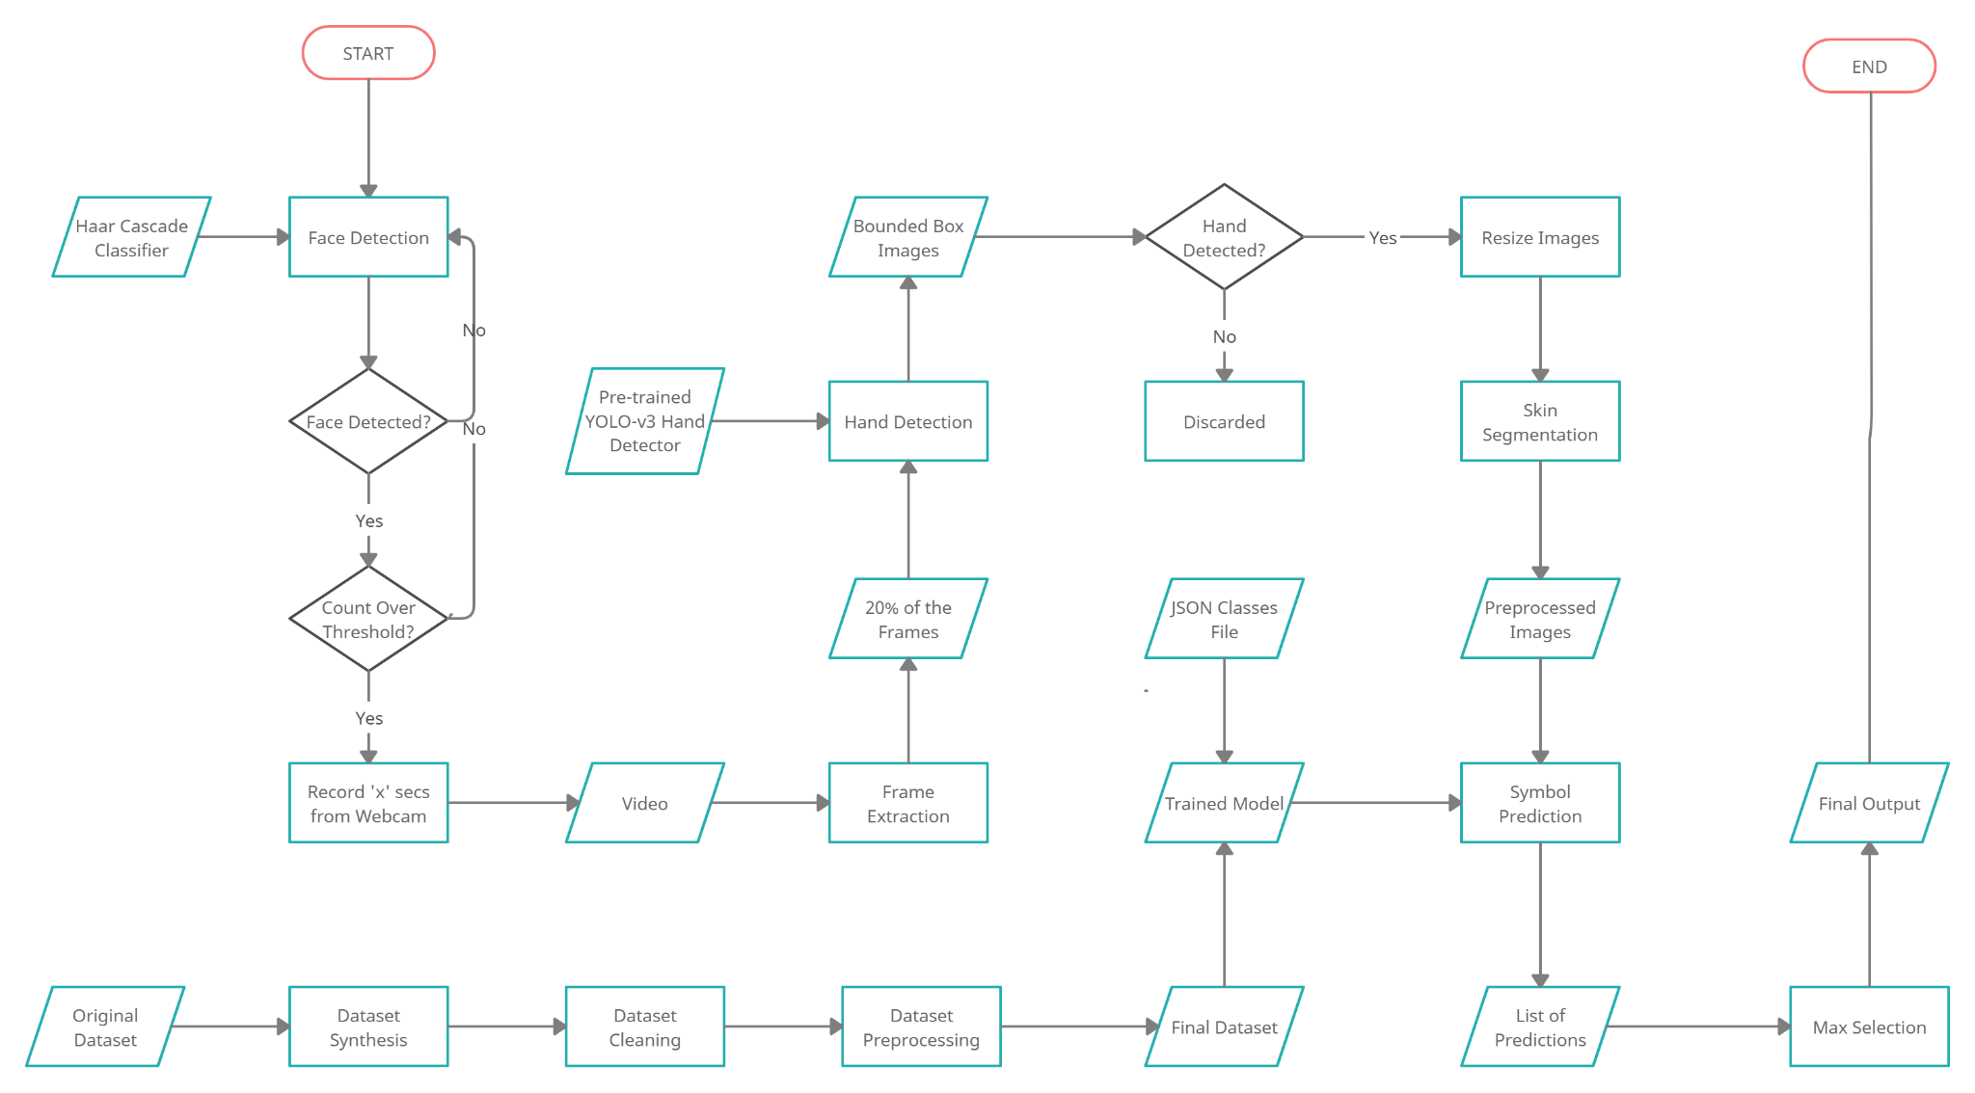
Our Implementation

Slide 6
Face Detection
Haar classifiers: A Haar classifier, or a Haar cascade classifier, is a machine learning object detection program that identifies objects in an image and video^{[1]}.
This approach has 3 main sub-components :
Introduction of a new image representation called the “Integral Image” which allows the features used by our detector to be computed very quickly.
A learning algorithm, based on AdaBoost, which selects a small number of critical visual features from a larger set and yields extremely efficient classifiers.
A method for combining increasingly more complex classifiers in a “cascade” which allows background regions of the image to be quickly discarded while spending more computation on promising object-like regions

Slide 7
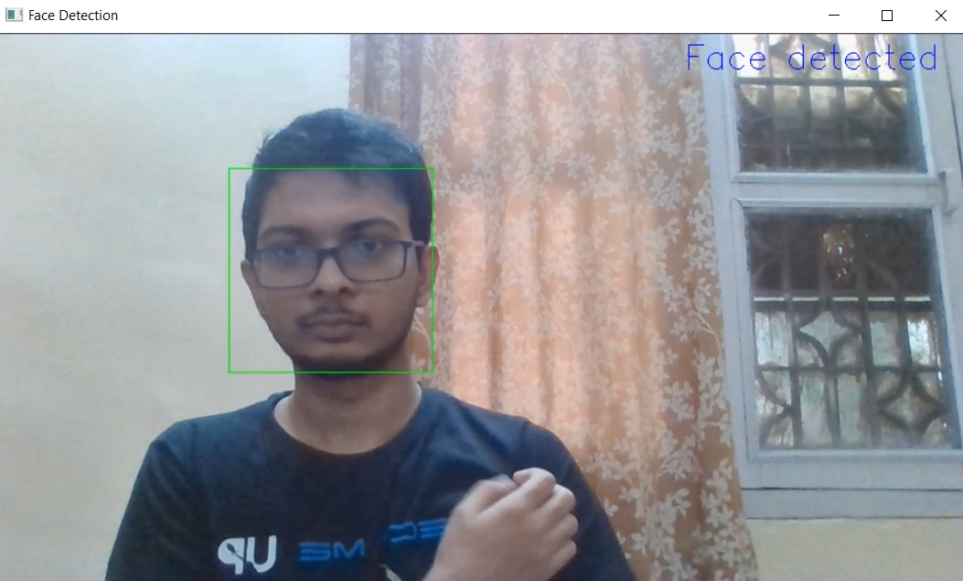
Face Detection
The OpenCV library provides us with pre trained Haar cascade models to detect faces in an image. When a face is detected, the program checks the next few consecutive frames, and when a threshold value of consecutive frames with a face in it is reached, the sign language system is triggered.
Output from the face detection program

Slide 8
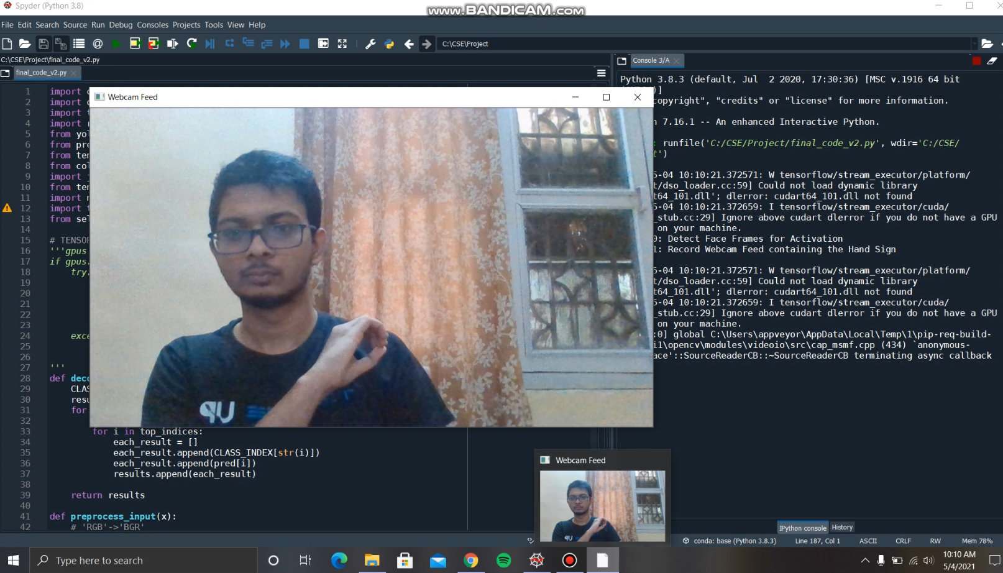
Webcam Feed
After the face detection phase is completed, webcam begins to capture video again. After a fixed amount of time (say x seconds), the recording process is completed. This x-second clip is saved into a folder using its timestamp.
A screenshot image of the webcam feed being recorded in the program

Slide 9
Frame Extraction
To extract the frames from the saved clip which will be passed to our model after preprocessing steps. We analyzed the three methodologies mentioned below:
Using all the frames in the video: used as a base condition.
Random Sampling: gives each frame an equal probability of being selected, and the sample chosen here will be an unbiased representation of the total population.
Key Frame Selection: process of extracting a frame or a set of frames that have a good representation of a shot.
After running tests with the first method as our base condition, we found that the Random Sampling method, where 20% of the frames were selected, was much faster and comparable in terms of accuracy, implying the the randomly chosen sample set was representative of the given clip.

Slide 10
Image Preprocessing
To fine-tune the input frames from our live feed and optimise it for our model, some additional preprocessing techniques were applied to the extracted frames. We applied three methods on these frames before passing them to the model.
The three methods used in the following process are:
Hand Detection
Resizing
Skin Segmentation

Slide 11
Hand Detection and Resizing
The first step in preprocessing is preliminary hand detection method, which goes through every frame selected from the clip, and attempts to find a hand in them using a YOLO-v3 pre-trained network.
If any hands are found in the frame, an extended bounding box is created around the hand(s). These images are then cropped to contain only the contents of the box, and are passed onto the next step of preprocessing which is resizing. If no hands are found, the frame is discarded entirely.
To maintain uniformity, all images are resized to (224, 224). These images were experimentally found to produce the correct output consistently in comparison to the other sizes.

Slide 12
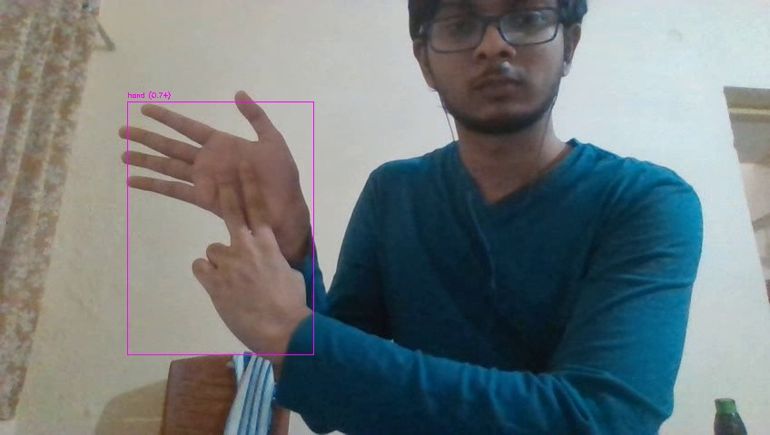
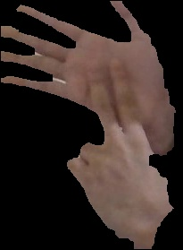
Skin Segmentation
After cropping and resizing, the images are passed through a combination of HSV (Hue, Saturation, Value) and YCbCr (Luminance, Chrominance) based filters to segment out skin and remove background noise present in the box input^{[2]}.
Webcam input with hand detection activated
Skin segmented input

Slide 13
Prediction: Dataset Synthesis
The dataset we had taken originally was an Indian Sign Language dataset containing 26 alphabet classes and 1200 images per class.
It was initially expected to be used for training the model to learn the hand signs. However, the dataset size was smaller than ideally expected for a dataset with 26 classes.
To solve this, data synthesis was performed over 20 classes, where each image of the class would get brightened/darkened and blurred randomly over fixed ranges to generate 18 subsequent images. These gave us a dataset of a much larger size, but presented us with a new problem of having noise-filled images.

Slide 14
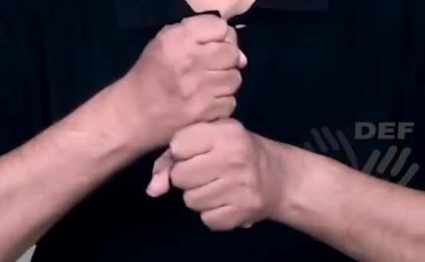
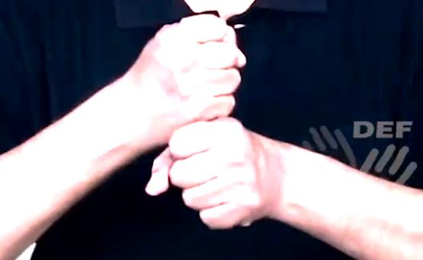
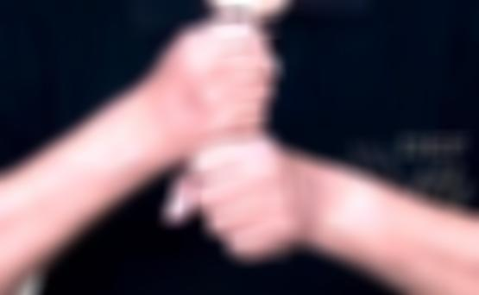
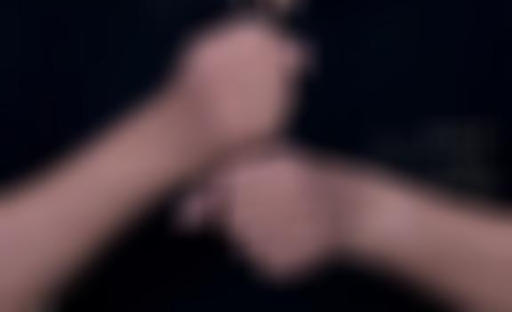
Prediction Dataset - sample images
Original input
Brightness shifted
Original image (top-left) and sample synthesized images
Blurred input
Brightness and blurring changed

Slide 15
Prediction: Dataset Cleaning
The larger synthesized dataset created the new problem - noisy images. To solve this, dataset cleaning was required.
This was also done with the hand detector used in preprocessing to see if the correct number of hands were detected from the image. The frames were then assigned to certain list(s) given the threshold confidence(s) that they satisfied.
From the list, we were able to shortlist the ten best performing signs and they were used for the final training process. The final dataset obtained contained 10 classes, and ~2300+ images per class.
This dataset is then further passed through the same preprocessing techniques as the extracted frames - hand detection, upscaling, and skin segmentation before it is passed to the model.

Slide 16
Prediction: Model Selection
The drawbacks in the previous approach were primarily attributed to overfitting, and the implemented model was chosen as a factor for improvement.
To overcome that limitation, we performed a model compatibility study among the following models, each selected due to their proximity to the date of creation of the original model and also their speed of processing factoring in time constraints:
DenseNet
Inception V3
SqueezeNet

Slide 17
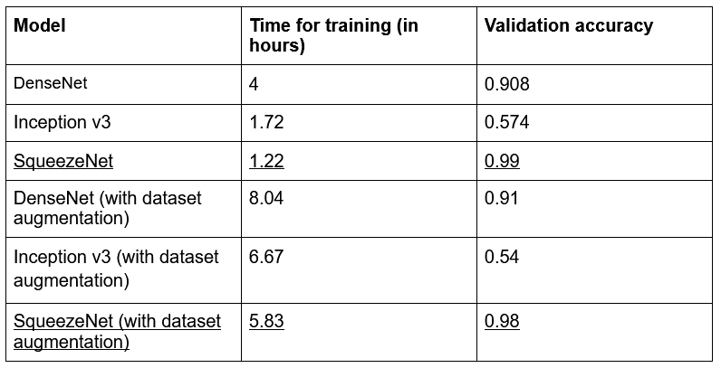
Prediction: Model Selection & Testing
As per test results, the SqueezeNet model strongly outperformed its peers in both aspects -
1.The accuracy provided (~ 0.98)
2.Time for training (minimum)
Thus, it has been selected for utilisation and described in the slide below.

Slide 18
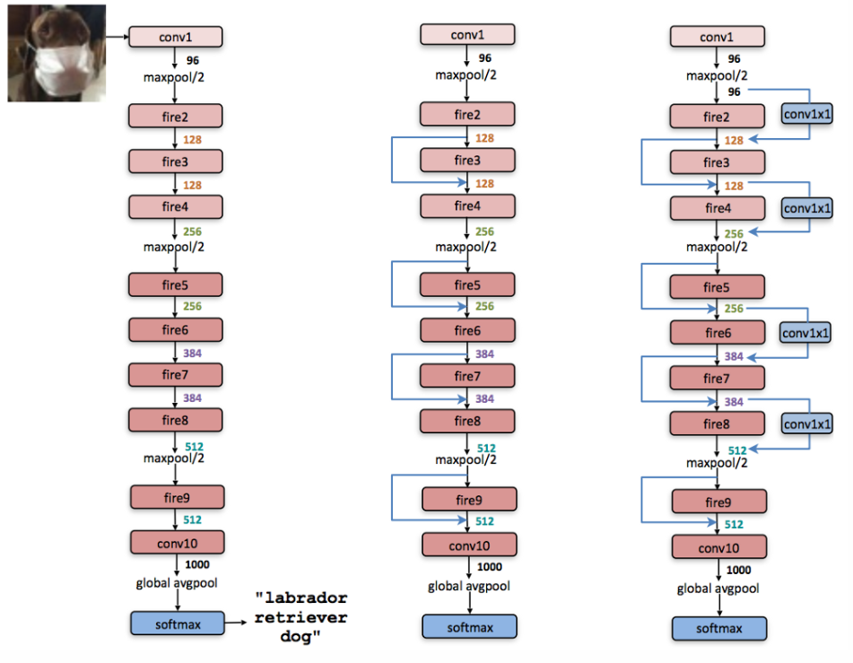
Prediction: About SqueezeNet
SqueezeNet: A brief Summary
SqueezeNet is a small DNN architecture which achieves AlexNet-level accuracy on ImageNet with 50x fewer parameters. Additionally, with model compression techniques SqueezeNet requires less than 0.5MB of storage (510x smaller than AlexNet)^{[3]}.
From left to right, SqueezeNet, SqueezeNet with simple bypass, and SqueezeNet with complex bypass

Slide 19
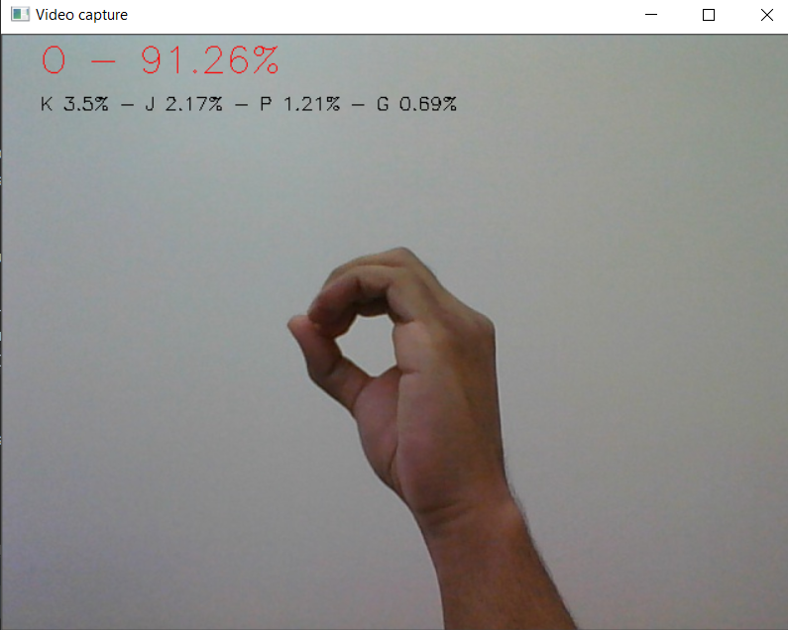
Final Output Selection
For every frame that was passed to the model, a sign was predicted. After this was done for all the frames, we compile a final result based on their outputs.
Frame selection methods such as Max selection and Roulette selection were compared.
In the end, Max selection method was chosen, where the alphabet/sign that appears in the most number of frames is considered as the final result.
output screenshot of an early prototype

Slide 20
Demo
We will now play a video recording of our project execution.

Slide 21
Current Limitations
The execution time is relatively higher than ideal.
The implementation currently runs once and ends. Instead, a continuously running process would be more favourable to run in real-life conditions.
Furthermore, a cleanup process which would delete all the files generated would also be required to run on a periodic basis to not waste storage resources.

Slide 22
Future Scope
Improve the execution time of the process by using libraries like pillow-simd to make it real-time in nature.
Create a continuously running implementation with an appropriate cleanup process.
Officially convert the project from Alphabet Notational Hand Gestures to Ideographic Notational Hand Gestures.
Integrate the project with a CCTV camera to help the target demographic, i.e. old hearing and speaking impaired patients.

Slide 23
Conclusion
In this project, we primarily worked towards improving the previous implementation of the Vision-based Sign Language Translator, and solved the majority of the issues present in the earlier version. The proposed algorithm, albeit slightly uneconomical, increases the adaptability of a hand gesture recognition system in near real-time.
By implementing hand/skin segmentation and face detection, the technique tries to reduce the time complexity and also works well under different degrees of scene background complexity and illumination conditions.
This project can be used as a blueprint for achieving a more efficient algorithm which is implemented in real-time expeditiously and optimistically help the community of the hearing and speaking impaired.

Slide 24
Timeline
October 2020: Literature Survey completed; Basic idea for implementation created
December 2020: Prototype created; Model finalized
January 2021: Dataset Synthesis done; Preprocessing approaches tested
March 2021: Dataset Cleaning done; Time Reduction approaches tested
May 2021: Final Product created

Slide 25
References
P. Viola and M. Jones, "Rapid object detection using a boosted cascade of simple features," Proceedings of the 2001 IEEE Computer Society Conference on Computer Vision and Pattern Recognition. CVPR 2001, 2001, pp. I-I, doi: 10.1109/CVPR.2001.990517.
Kolkur, S. & Kalbande, Dhananjay & Bapat, C. & Jatakia, Janvi. (2017), “Human Skin Detection Using RGB, HSV and YCbCr Color Models,” 10.2991/iccasp-16.2017.51.
Iandola, Forrest N., et al, "SqueezeNet: AlexNet-level accuracy with 50x fewer parameters and< 0.5 MB model size," arXiv preprint arXiv:1602.07360 (2016).
Redmon, Joseph & Farhadi, Ali. (2018). YOLOv3: An Incremental Improvement.

